Slide 1
Sales
How to submit a sample request

Slide 2
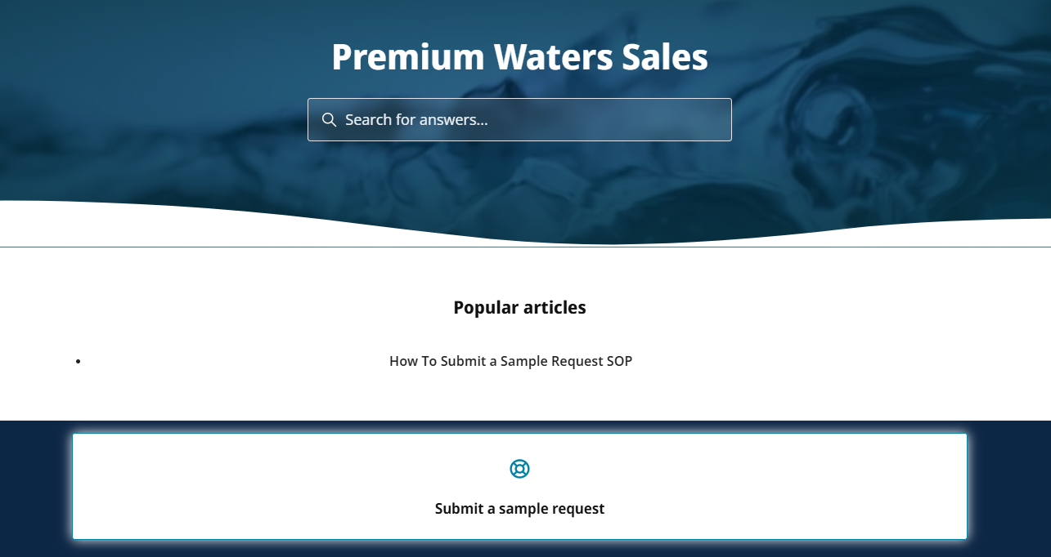

Website
https://premiumwaterssales.zendesk.com/hc/en-us
Click Here to Learn How to Submit a Sample Request
Submit a Sample Request – Click Here

Slide 3
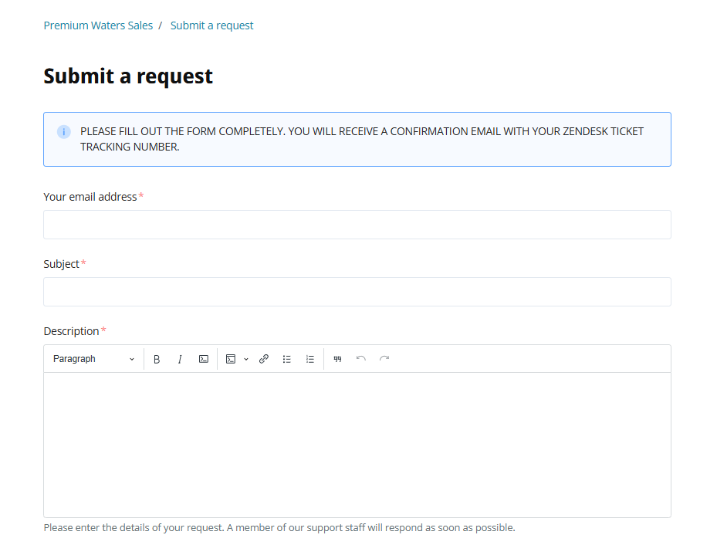
Enter Information
j.doe@premiumwaters.com
Sample request
Text Field

Slide 4
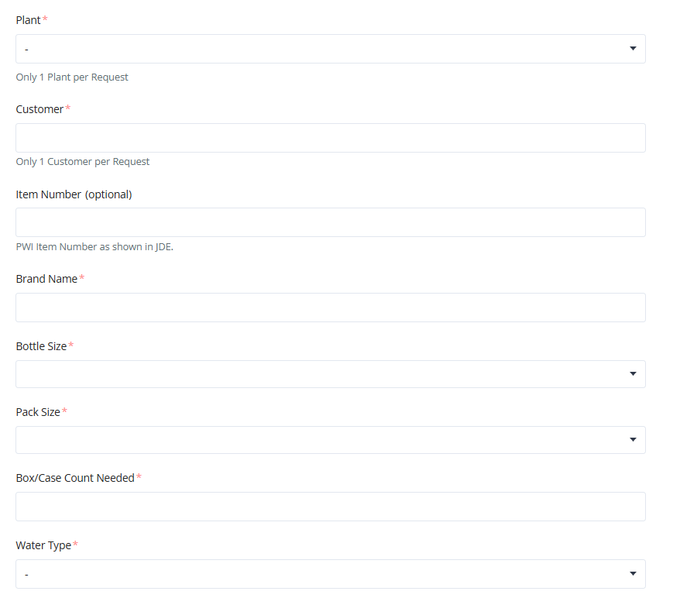
Enter Information
Pull-down menu to select plants/s
Enter customer
Enter Brand Name
Pull-down menu to select bottle size
Pull-down menu to select Pack Size
Enter number of cases/boxes needed
Pull-down menu to select Water Type

Slide 5
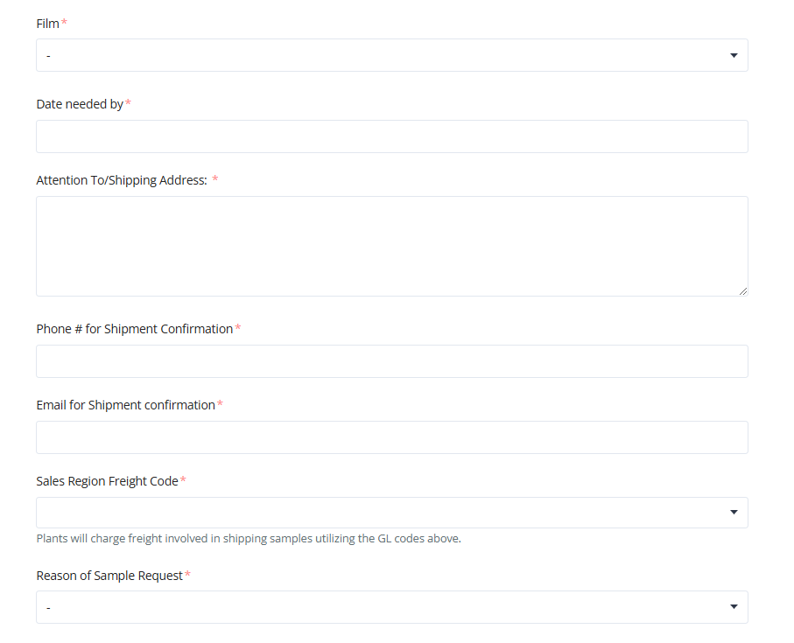
Enter Information
Pull-down menu to select type of Film
Select date by using calendar
Enter attention to and shipping address for shipment recipient
Enter phone number for shipment recipient
Enter email for shipment recipient
To be entered later
Pull-down menu to select Reason of Sample Request

Slide 6
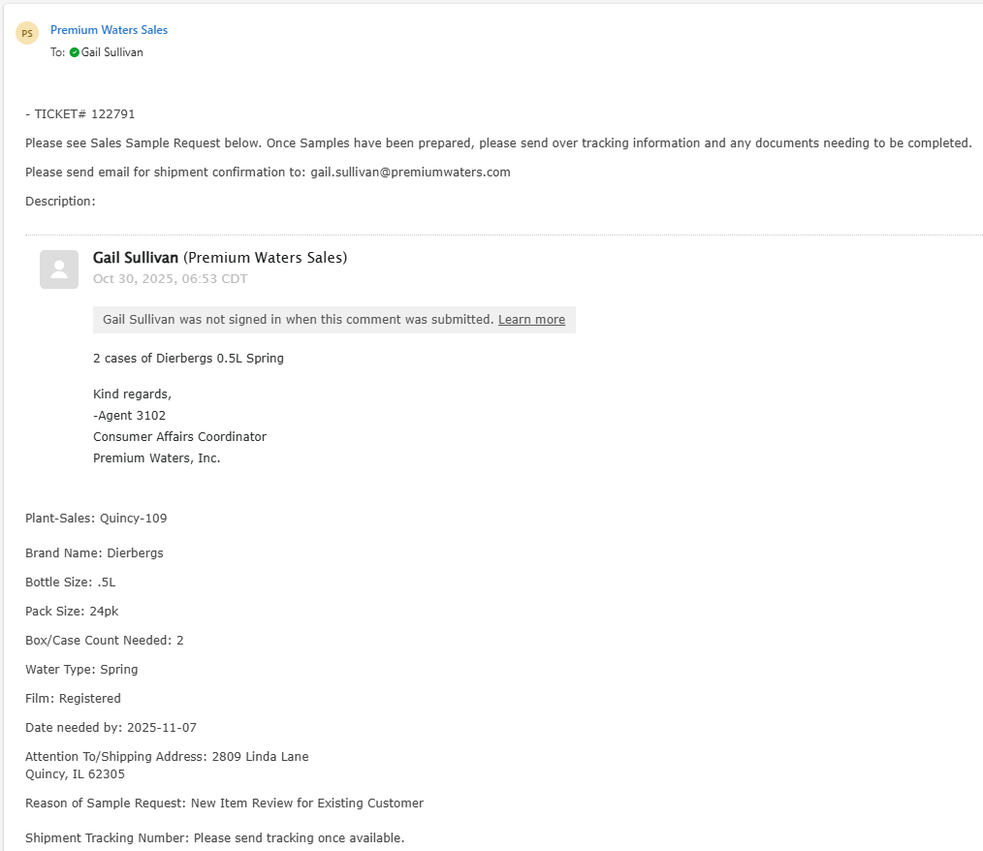
The requester will receive an email confirmation.

Slide 7
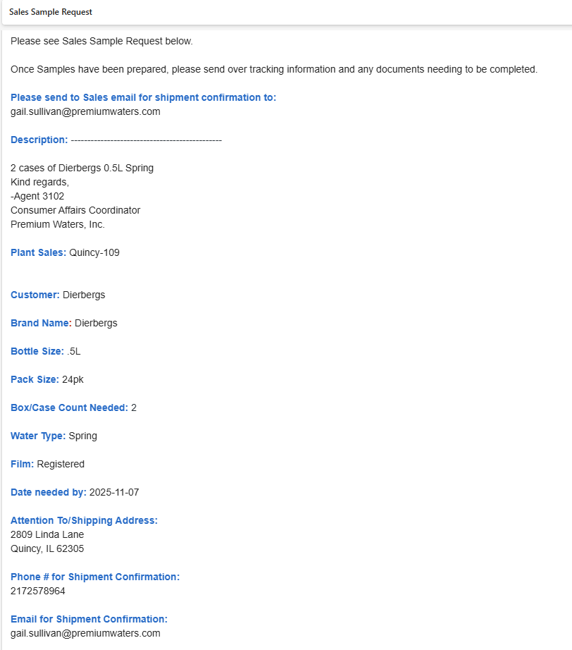
The email the Plant and CSR Riverside will receive.
Once the Plant prepares the shipment, they will reply with the tracking numbers.

Slide 8
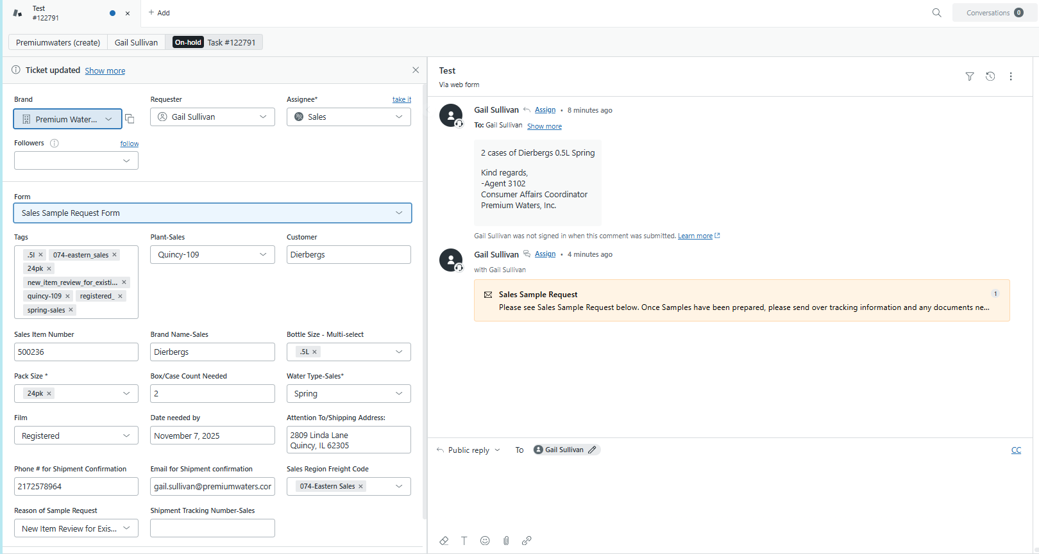
Example of Ticket in Zendesk

